Slide 1
Communication in Distributed Systems

Slide 2
Outline
Interprocess communication
Client server model
distributed system, it is completely different from uniporcessor system as there is no shared memory.

Slide 3
Interprocess Communication
In distributed system, it is completely different from uniporcessor system as there is no shared memory.
Certain rules need to be followed for interprocess communication called Protocols.
For wide area distributed systems, these protocols take the form of multiple layers such as OSI , ATM.
OSI model addresses only a small aspect of the communication - sending bits from the sender to the receiver, with much overheads.

Slide 4
Client - Server model
It is based on simple connectionless request / reply protocol.
Client sends a request message to the server and the server returns the data requested or an error code indicating the reason of failure.
It is simple. No connection to be established before use and no connection to be closed after use.
Simplicity leads to efficiency. Only three levels of protocol are needed.
Client
Request
Server
kernel
Reply
kernel

Slide 5
Client - Server model
Physical and datalink protocol take care of getting the packets from client to server and back.
No routing and no connections - layers 3 & 4 not needed.
Layer 5 is the request/ reply protocol. No sessions required.
Communication provided by the micro-kernels using two system calls -
send (dest, &mptr)
receive(addr, &mptr)
mptr - message pointer
dest - destination process
addr - source address
7
6
5 Request / reply
4
3
2 Datalink
1 Physical

Slide 6
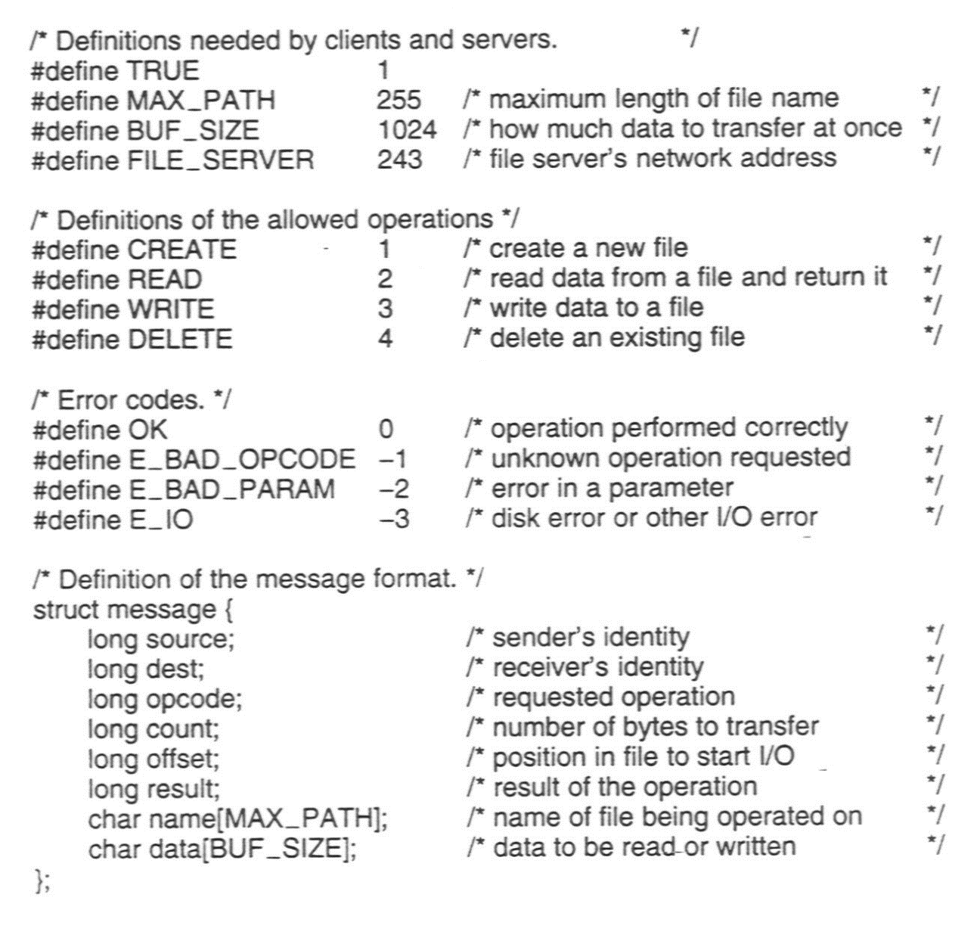
Example - client and server
Speed - A distributed system may have more total computing power than a mainframe.
header.h

Slide 7
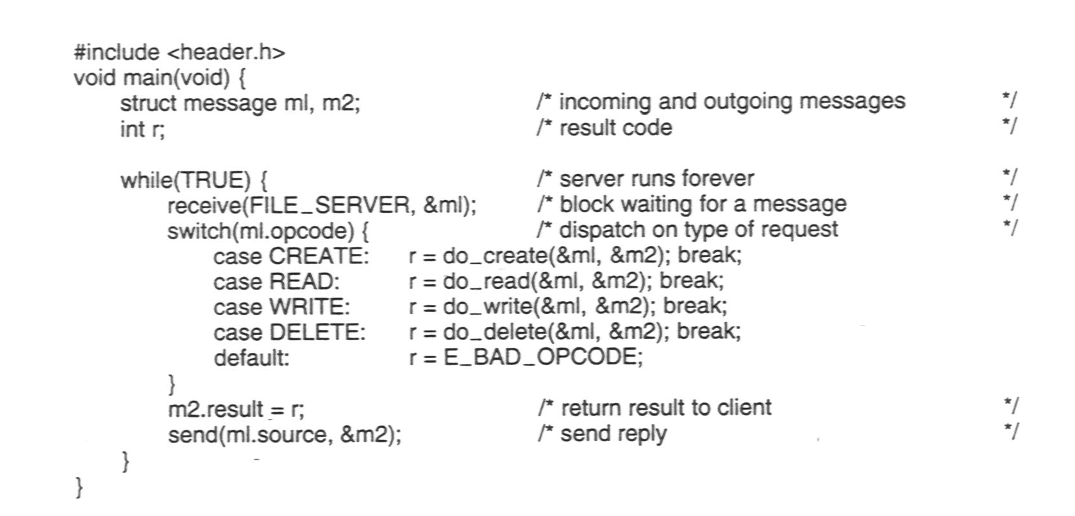
Example - client and server
A sample server.

Slide 8
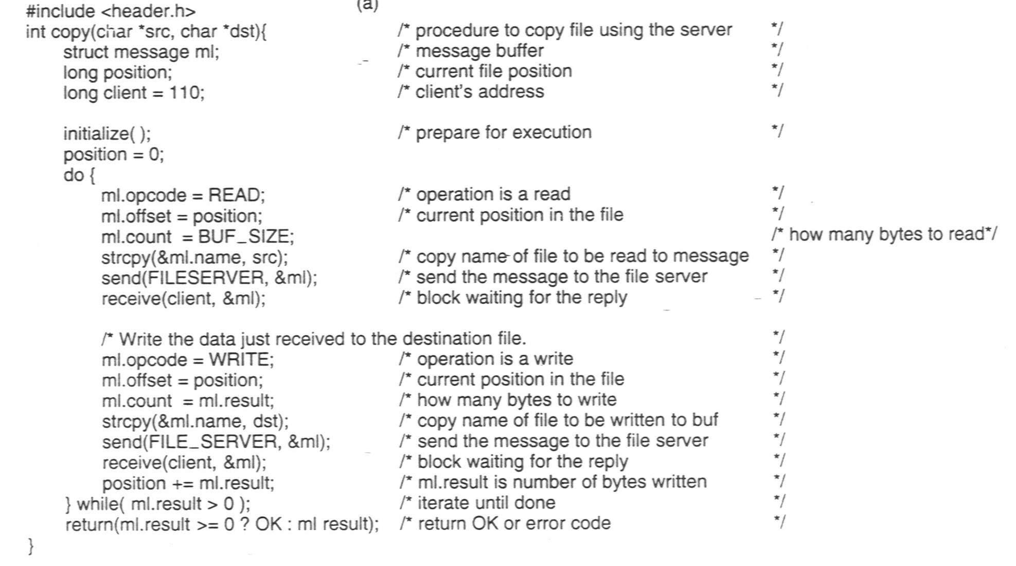
Example - client and server
A client using the server to copy a file.

Slide 9
Addressing
One way of mentioning server address is to mention it in header.h as a constant.
Sending kernel can extract it (ex - 243) from message structure and use it for sending packets to server.
Ambiguity arises if multiple processes are running on the same server.
Alternative 1 -
Send messages to processes , not machines.
Process identification - two part names - machine + process no.
Ex - 243.4 or 4@243
Each machine can number its processes starting from 0. So there is no confusion between process ‘n’ of different machines.
No global coordination is required.
1
Client
Server
1. Request to 243.0
2. Reply to 199.0
kernel
2
kernel

Slide 10
Addressing
Alternative 2 -
use machine.local-id instead of machine.process
Each process is assigned a local-id and informs kernel that it listens to local-id
Problem - user is aware of the location of the machine (243). If the machine is down, compiled programs with header.h will not work, although another machine (365) is available. No transparency.
Alternative 3-
Each process has a unique address that doesn’t contain machine number.
A centralized process address allocator maintains a counter. Upon receiving a request, it returns the current value of the counter.
Problem - Such centralized components do not scale to large systems.

Slide 11
Addressing
Alternative 4 -
Each process picks its own identifier from a large address space (space of 64 bit binary integer).
It is scalable.
Identification of machine -Sender broadcasts a special Locate packet containing the address of the destination process. It will be received by all machines on the network. The matched kernel respondes with a message “here i am” alongwith the machine number. So the sending kernel uses this machine number for further communication.
Problem - Broadcasting is an overload to the system.
3
Client
Server
1. Broadcast
2. Here I am
3. Request
4. Reply
kernel
4
kernel
1
1
2

Slide 12
Addressing
Alternative 5 -
Overload can be avoided by providing an extra machine to map high-level (ASCII) service names to machine address.
These names are embeded in the programs, not binary machine numbers.
For the first time client sends a query to the Name server, asking the machine number where the server is currently located. Then the request can be sent directly to the machine address.
Problem - If the name server is replicated, consistency problem may arise.
1.Lookup
2. NS reply
3. Request
4. Reply
3
1
Server
Client
Name Server
kernel
4
kernel
2
kernel

